Slide 1
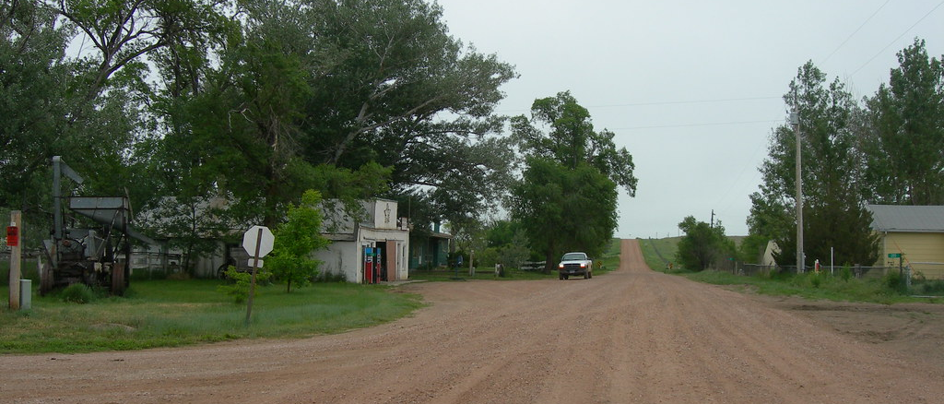

Gravel Road Maintenance Policy
RM of St. Clements

Slide 2

Introduction
Purpose: Establish guidelines for the efficient management and maintenance of gravel roads.
Goals: Enhance road safety, accessibility, and overall quality

Slide 3
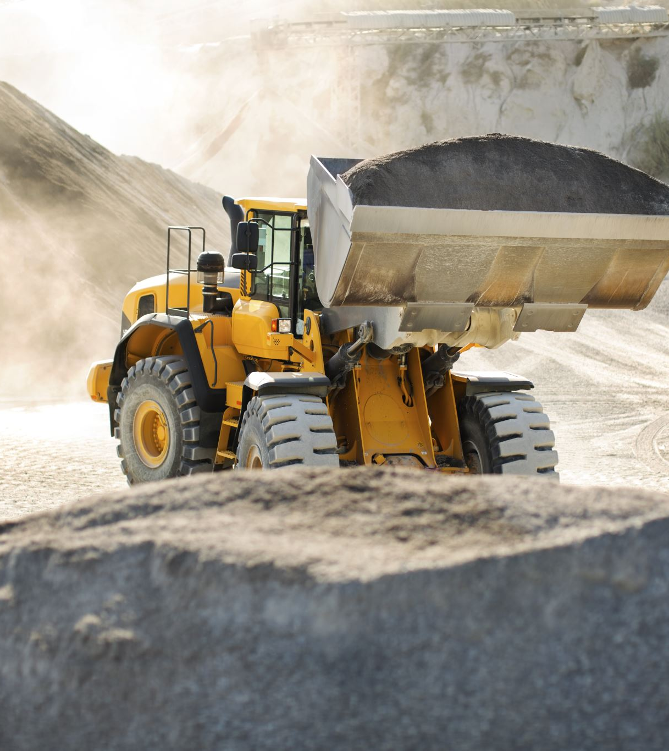
Policy Objectives
Maintain and improve the condition of gravel roads.
Ensure safe and accessible travel for all road users.
Establish a systematic approach to gravel road maintenance.

Slide 4
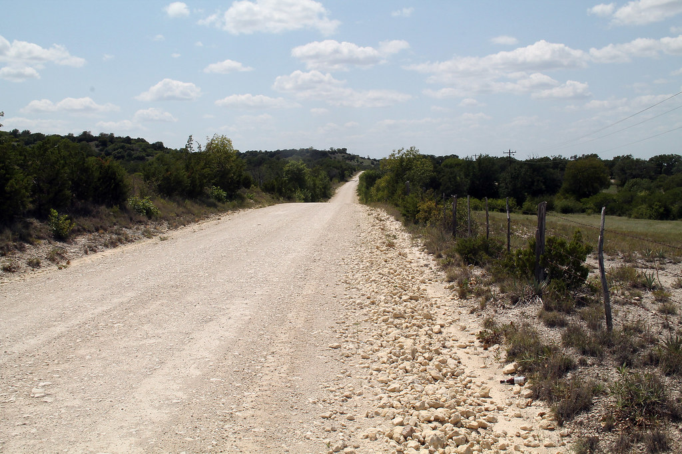
Policy Statement
Road Surface Maintenance: Grading, surface drainage, dust control, material application, subgrade repair and stabilization, drainage management.
Specific Procedures: Detailed steps for grading, dust control, material application, subgrade repair, and drainage management.

Slide 5
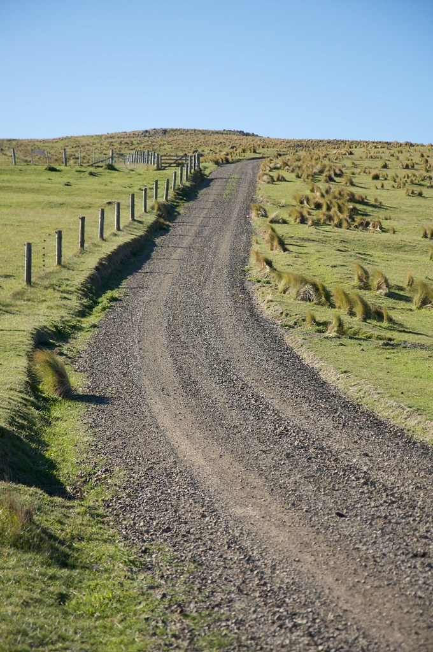
Responsibilities
Public Works Department: Responsible for implementation and enforcement of the policy.
Regular Inspections: Conducted to ensure compliance with policy guidelines.
Annual Review: Policy will be reviewed annually and amended as necessary.
This Photo by Unknown Author is licensed under CC BY-NC

Slide 6

Conclusion
Benefits: Improved road conditions, enhanced safety, and accessibility for all road users.
Effective Management: The policy provides a framework for efficient and effective gravel road maintenance.

