Slide 1


Hard Surface Road Rehabilitation & Reconstruction Policy
RM of St. Clements

Slide 2

Introduction
Need for a comprehensive policy to maintain and reconstruct hard-surfaced roads.
Council’s Direction: Establish a policy to address road deterioration and prevent extensive damage.
Goal: Develop a defensible policy that aligns with industry standards and considers budget constraints.

Slide 3

Policy Framework
Key Points:
Recognize the importance of maintaining hard-surfaced roads.
Acknowledge the wear and tear of roads over time.
Emphasize the need to address deterioration promptly.
Require administration to report on road inventory and costs.
Policy Components:
Purpose, definitions, responsibilities, procedures, funding, and review process.

Slide 4

Addressing Council's Resolution
Inventory: Requirement for an up-to-date inventory of all hard-surfaced roads.
Identification: Process for identifying roads needing maintenance or reconstruction.
Cost Estimates: Requirement to prepare cost estimates for reconstruction projects.
Reporting: Mechanism for CAO to present plans and cost estimates to Council.

Slide 5
Beyond the Resolution
Planning: 5-year planning cycle for road maintenance and reconstruction.
Inspections: Regular inspections and condition assessments.
Prioritization: Process for prioritizing road projects based on condition, traffic volume, and strategic importance.
Funding: Provisions for exploring additional funding sources.

Slide 6
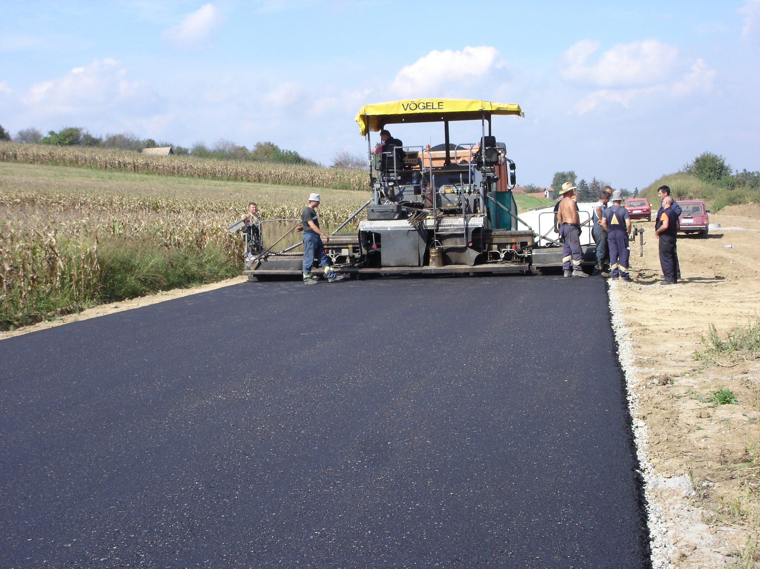
Scoring Methodology
Scoring Categories: Road Condition, Traffic Volume, and Strategic Importance.
Road Condition: Detailed criteria for surface cracking, potholes, rutting, edge deterioration, and drainage.
Traffic Volume: Based on Average Daily Traffic (ADT).
Strategic Importance: Connectivity, emergency routes, and economic impact.
Scoring Process: Annual inspections, scoring each road segment, and prioritizing based on total scores.
Prioritization: Grouping road segments into priority levels (Critical, High, Moderate, Low).
Reporting: Annual report to Council.
Review: Provision for annual review and adjustment of the methodology.

Slide 7
Benefits of the Scoring Methodology
Inventory: Supports an up-to-date inventory.
Inspections: Provides a structured approach for annual inspections.
Assessment: Offers a detailed system for rating roads.

Slide 8
Conclusion
Comprehensive Policy: The policy provides a solid foundation for managing hard-surfaced roads in the RM of St. Clements.
Scoring Methodology: The methodology supports objective and consistent assessment and prioritization.
Implementation: By implementing this policy and methodology, the RM can effectively manage its road infrastructure.

